Slide 1
Twitter Sentiment Analysis using Deep Learning Models
Jiaying Guo
Ang Li
Yuan Li
Yujie Sun
Shiping Yi

Slide 2
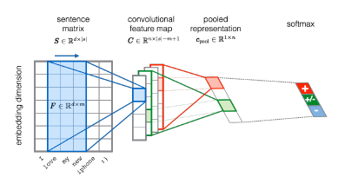
Illustrative example
Severyn, A., & Moschitti, A. (2015). Twitter Sentiment Analysis with Deep Convolutional Neural Networks.

Slide 3
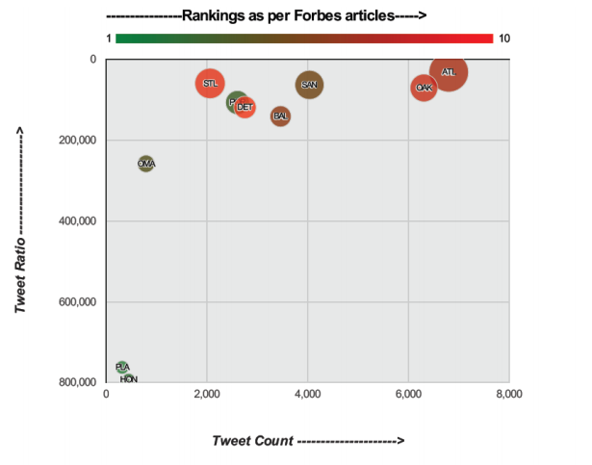
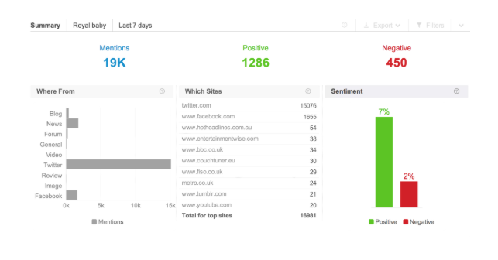
Applications of Sentiment Analysis
There have been many breakthroughs with Natural language processing techniques that have paved the way for commercial advertising, social media monitoring of elections, as well as detecting criminal activity from user tweets.
https://www.brandwatch.com/blog/understanding-sentiment-analysis/
Bolla, Raja Ashok (2014). Crime Pattern Detection using Online Social Media

Slide 4
Problem Definition
Achieve the state-of-the-art performance using deep learning methods (Convolutional Neural Networks specifically) to train a set of pre-processed dataset obtained from user tweets.
Extensions:
Feed manually-annotated user tweets related to Covid-19 into the trained final model and derive accuracy results
Use other word-embedding features to train the network and compare performance
Vary model architectures to incorporate LSTM into the baseline model

Slide 5
Past Approaches
Naive Bayes
Logistic Regression
CNN with pre-trained word embeddings
CNN with POS tags as additional input features
LSTM
Combination of CNN and LSTM
CNN and GRNN

Slide 6
Simple Baseline Performance
We used a simple baseline that predicts positive for a sentence based on the number of positive words versus negative words
Sentiment140 dataset was split into train, test, and dev by 0.75: 0.2: 0.05
Dataset | Precision | Recall | F1 score
Train | 70.24% | 89.42% | 78.68%
Validation | 69.89% | 89.64% | 78.55%

Slide 7
Baseline Model Architecture
Weight initialization
Word2vec model (300d) to learn embeddings on unlabeled tweet corpus
Distant supervision with NN to refine embeddings
Layers
One layer of Convolutional Layer, number of filters = 300, filter size = 5
One layer of max pooling
One layer of RELU
One layer of fully-connected softmax
Optimization
Stochastic Gradient Descent (Adadelta)
Regularization
L2-normalization, dropout = 0.5

Slide 8
Chosen Dataset
Severyn, A et. al (2015) uses the dataset from Semeval-2015 Twitter Sentiment Analysis Challenge.
T4SA Dataset - Twitter for Sentiment Analysis Dataset used by Vadicamo, L. et. al (2017)
unlabeled Covid tweets from Kaggle

Slide 9
Preliminary Results
After training for 5 epochs, our results on training set, validation set and test set are as follows:
Dataset | Precision | Recall | F1 score
Train | 88.55 | 87.74 | 88.12
Validation | 93.96 | 93.04 | 91.04
Test | 93.72 | 90.60 | 92.00

